Slide 1

Great American Scientists
Created by Quang Huynh
Checked by Ben Gorman

Slide 2
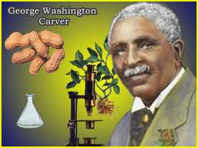
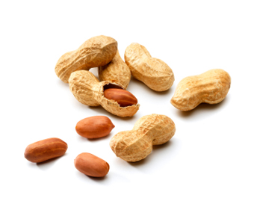
George Washington Carver
George Washington Carver’s parents were born as slaves and are slave of owners, Moses and Susan Carver
As an infant, George was free, and became an orphan
George Washington Carver got a Master’s Degree in Agriculture in 1896
George W. Carver made many uses for peanuts.
George Washington Carver was a botanist, or a plant scientist.
Was born in Diamond, Missouri, in 1864
George’s parents’ names were Mary and Giles

